Slide 1
CIS 286 Introduction to Data Structures-Java
Chapter 9
Recursion-Part 2

Slide 2
Recurrence Relations
Suppose you have an infinite list of items
  For example, 2, 4, 8, 16, 32, 64, …
Looking at the list, we can see a pattern
We want a formula that shows this pattern
  It should describe an item based on the item(s) before it
  We also need to note the starting number
The formula is called a recurrence relation

Slide 3
Deriving a Recurrence Relation from a List
The book has the method countDown
public void countDown (int n)
{
System.out.print (n);
if (n > 1)
countDown (n-1);
}
Let’s analyze the time required by this method

Slide 4
Getting the Time
There is 1 print statement
  I will ignore this in the analysis
There is 1 comparison
There may be 1 call to countDown
  This is recursion!
Suppose it takes 3 seconds to call countDown
  Since we don’t actually know the time, let’s call this t(n)
    t stands for time
    n stands for the n in countDown (int n)
    The time is based on n, because countDown can call itself repeatedly

Slide 5
Back to Recurrence Relations
So, we have these formulas
  t(1) = 1
    This means countDown (1) has one basic operation
      That’s the compare
  Otherwise, t(n) = 1 + t(n-1)
    The 1 is for the compare
    The t(n-1) is for the recursion

Slide 6
Solving the Recurrence Relation
Here is the recurrence relation
  t (1) = 1
  t (n) = 1 + t (n-1)
We want a formula based on position, not on the other items in the list
We start by listing the first four times
  t(1) = 1
  t(2) = 1 + t(2-1) = 1 + t(1) = 1 + 1 = 2
  t(3) = 1 + t(3-1) = 1 + t(2) = 1 + 2 = 3
  t(4) = 1 + t(4-1) = 1 + t(3) = 1 + 3 = 4
We try to guess at a pattern

Slide 7
Finding the Pattern
Here is what we have to do
Position | Formula
1 | 1
2 | 2
3 | 3
4 | 4
n | ?

Slide 8
Verifying the Pattern
The method we use to verify our guess is called mathematical induction
It has two parts
  A starting point (Called the base step)
  The inductive step
The idea behind it is this
  We prove that the formula holds when we substitute 1 into the formula
  We then prove, that, if the formula holds when we substitute a number for n, it also holds for n+1

Slide 9
Verifying that t(n) = n
Part 1
The Base Step
  t(1) = 1 (the actual value)
  t(1) = 1 (the value predicted by the formula)
  Since these are the same, the base step is verified

Slide 10
Verifying that t(n) = n
Part 2
For the next part, we assume that t(n) = n
We have to prove that t(n+1) = n+1
Here is that proof
  t(n+1) = 1 + t(n) (by the recurrence relation)
  = 1 + n (by our assumption)
We are done!

Slide 11


Another Example of a Recurrence Relation
A truly sneaky way to evaluate x^{n} is by recursion
  The hardware does something similar to this for division!
If n is an even number, then
If n is an odd number, then

Slide 12

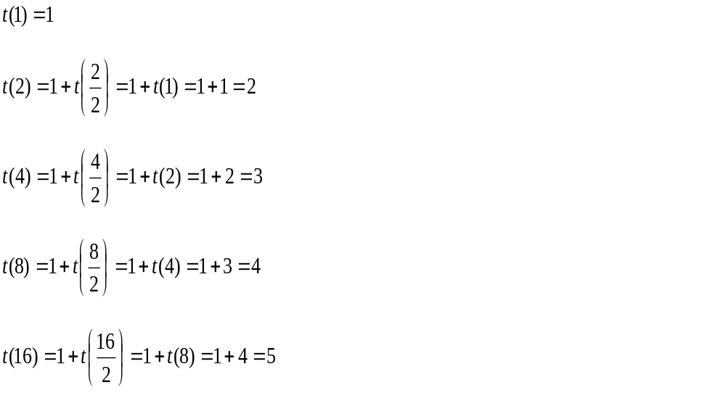
Analyzing This Algorithm
Here for the even exponents
To get the pattern we try some examples

Slide 13
Finding the Recurrence Relation
If you multiply n by 2, you add 1 to the time
  This is a logarithmic relation
So we find t(n) = 1 + log₂(n)

Slide 14
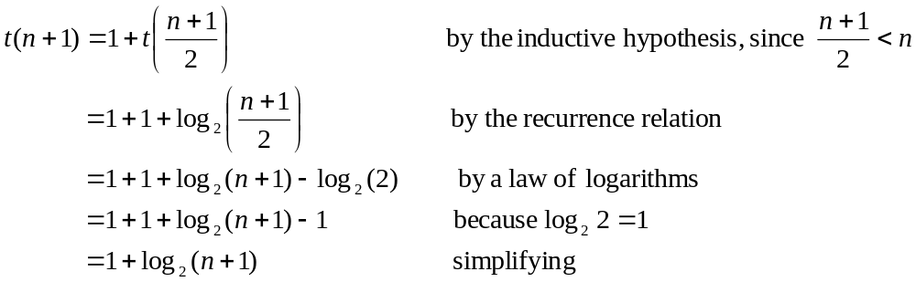
Verifying the Recurrence Relation
By induction, of course!
  Actually, this is strong induction
Base step
  t(1) = 1 (Actual value)
  t (1) = 1 + log₂(1) = 1 + 0 = 1
Inductive step
  We assume that t(n) = 1 + log₂(n)
  We have to show that t(n+1) = 1 + log₂(n+1)
  Verification:

Slide 15
Analyzing the
Towers of Hanoi
Suppose m(n) stands for the (total) number of moves required for n disks
So, m(1) = 1, and
m(n) = m(n-1) + 1 + m(n-1)
= 2m(n-1) + 1
As before, we want to find a formula for m(n)

Slide 16
Checking Some Easy Cases to Find the Formula
m(1) = 1
m(2) = 2m(2-1) + 1
= 2 (1) + 1 = 3
m(3) = 2m(2) + 1 = 2(3) + 1 = 7
m(4) = 2m(3) + 1 = 2(7) + 1 = 15

Slide 17
Finding the Formula
It looks like the formula is
  m(n) = 2^{n} – 1
We verify that by induction

